Slide 1
Mediator Pattern

Slide 2
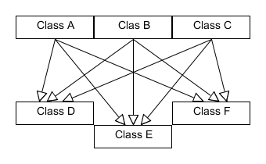

Slide 3
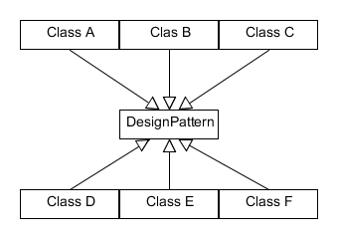

Slide 4
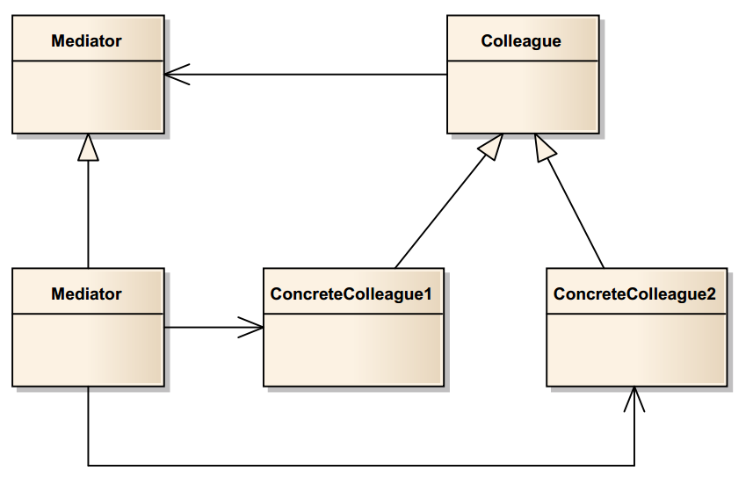

Slide 5
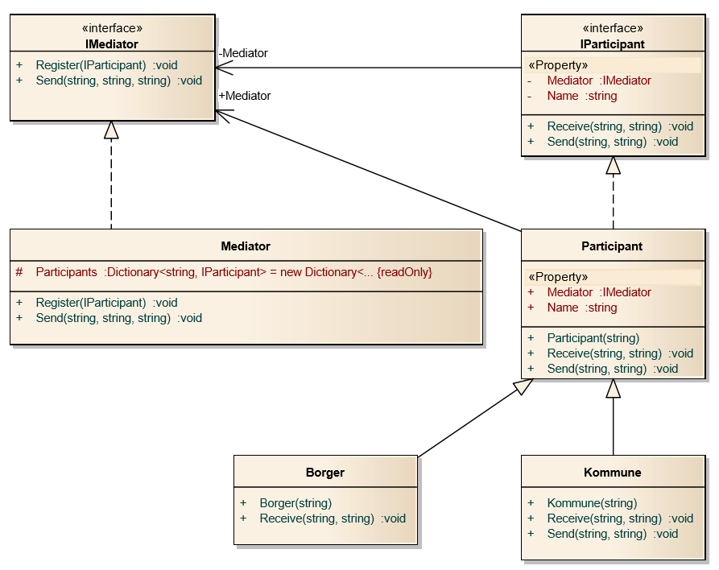

Slide 6
static void Main(string[] args)
{
Mediator Chatroom = new Mediator();
Participant Dennis = new Borger("Dennis");
Participant Joachim = new Borger("Joachim");
Chatroom.Register(Dennis);
Chatroom.Register(Joachim);
Dennis.Send("Joachim", "Herro Jokke!");
Joachim.Send("Dennis", "Hello Dennis");
}

Slide 7
protected Dictionary<string, IParticipant> Participants;
public virtual void Register(IParticipant participant)
{
Participants[participant.Name] = participant;
participant.Mediator = this;
}

Slide 8
public virtual void Send(string to, string message)
{
Mediator.Send(Name, to, message);
}

Slide 9
public virtual void Send(string from, string to, string message)
{
IParticipant participant = Participants[to];
participant.Receive(from, message);
}

Slide 10
public virtual void Receive(string from, string message)
{
Console.WriteLine(from + " to " + Name + ": " + message);
}

Slide 11
Sammenligning med publisher-subscriber
Forskelle og ligheder

Slide 12
Fordele
Forståelighed, overskuelighed
Lav kobling
Simplificerer protokollen mellem objekter

Slide 13
Ulemper
Kompleksitet
Single point of failure

Slide 14
Konklusion

